Slide 1

Title:
Let’s
Donate
Blood
Theme | MAINTANANCE & CONTINUITY OF LIFE
Learning Area | 3.0 TRANSPORTATION
Content Standard | 3.3 Human Blood
Learning Standard | Activity 3.6 To understand and solve issues related to blood donation in the context of daily life based on projects using the STEM approach
Group Member | Phay Tze Xin(3 Kristal) Muhammad Iman Hakimie(3 Kristal) Tye Hong Sen(3 Kristal)

Slide 2
Index
Important To Donate Blood………………………………………………………………..1
BLOOD DONOR ELIGIBILITY CRITERIA…………………………….......................2
Methods of Storing and Handing/Returns Donated Blood……………….3-5
Learn About Each Step of the Blood Journey……………………………………6-8
Advantages and disadvantages of donating blood………………………………9
QR CODE……………………………………………………………………………………………10

Slide 3
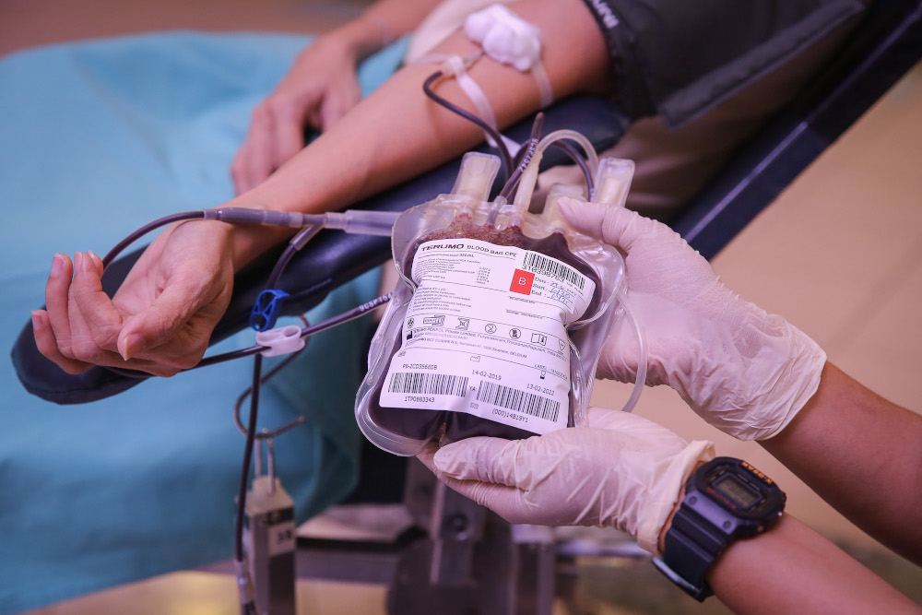
Important To Donate Blood
To Save People
Safe blood saves lives and improves health. Blood transfusion is needed for: 1.Children with severe anaemia often resulting from malaria or malnutrition
2.People with severe trauma following man-made and natural disasters
3.Many complex medical and surgical procedures and cancer patients
It is also needed for regular transfusions for people with conditions such as thalassaemia and sickle cell disease and is used to make products such as clotting factors for people with haemophilia. Blood is the most precious gift that anyone can give to another person — the gift of life. A decision to donate your blood can save a life, or even several if your blood is separated into its components — red cells, platelets and plasma — which can be used individually for patients with specific conditions.
Copyright © WHO World Health Organization
1

Slide 4
2. BLOOD DONOR ELIGIBILITY CRITERIA
You can donate blood if:-
1.Well and Healthy
2.Age:
a. First time donor: 18-60 years old
b. Regular donor: 18-65 years old
c. Prospective donor aged 17 years old must provide written consent from his or her parents / guardian
3. Weight : 45kg and above
4. Had minimum of 5 hours sleep
5. Had a meal before blood donation
6. No medical illness
7. Not involved in any high risk activities such as :-
a. Same gender sex (homosexual)
b. Bisexual
c. Had sex with commercial sex worker
d. Change in sexual partner
e. Took intravenous drug
f. A sexual partner of any of the above
8. Last whole blood donation was 3 months ago
9. For female donors : not pregnant, last menstrual period was more than 3 days ago, and not breastfeeding
Copyright © University Of Malaya Medical Center
2

Slide 5
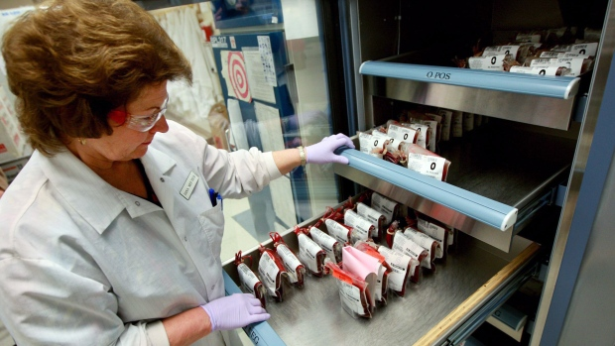
3. Methods of Storing and Handing/Returns Donated Blood
Storing
Red Blood Cells
Red cells can stored in Blood Bank refrigerators at 1-6ºC for up to 42 days.
Plasma
Frozen Plasma is maintained in the Blood Bank freezer at a temp ≤-18ºC.
Platelets
All platelets are stored at room temperature (20-24ºC) for up to 5 days from the date of collection.
3

Slide 6
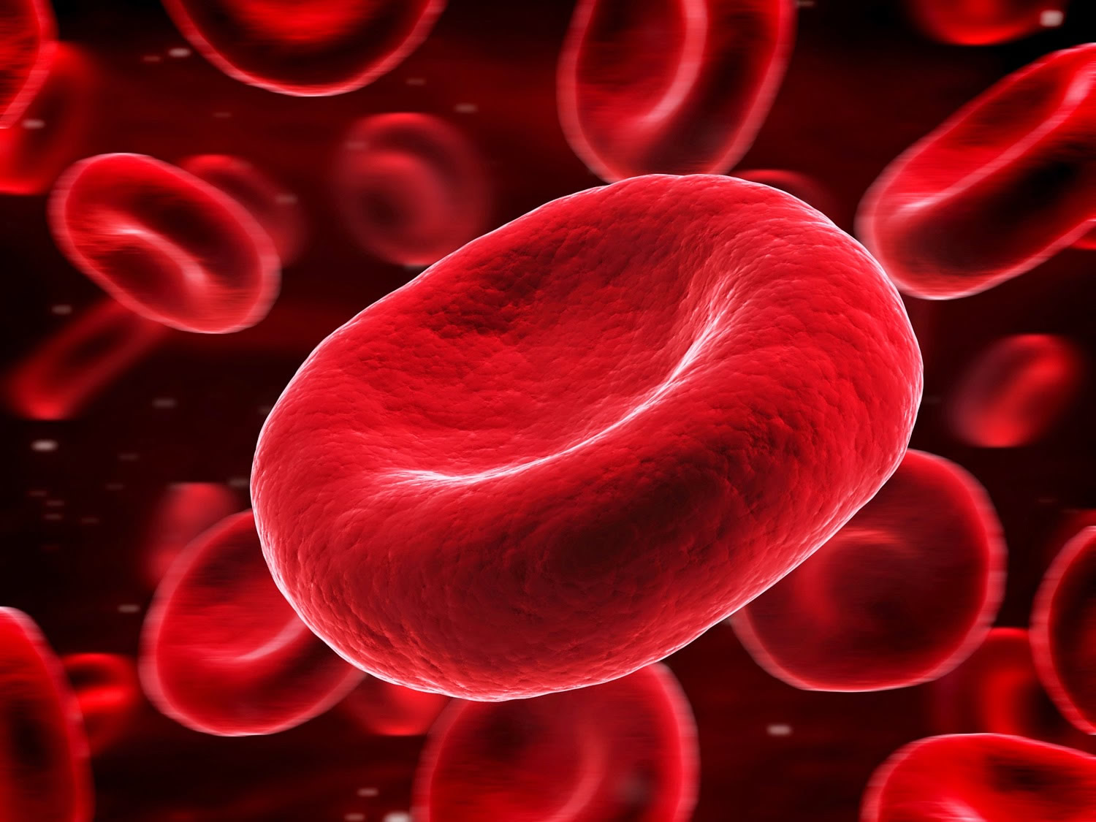
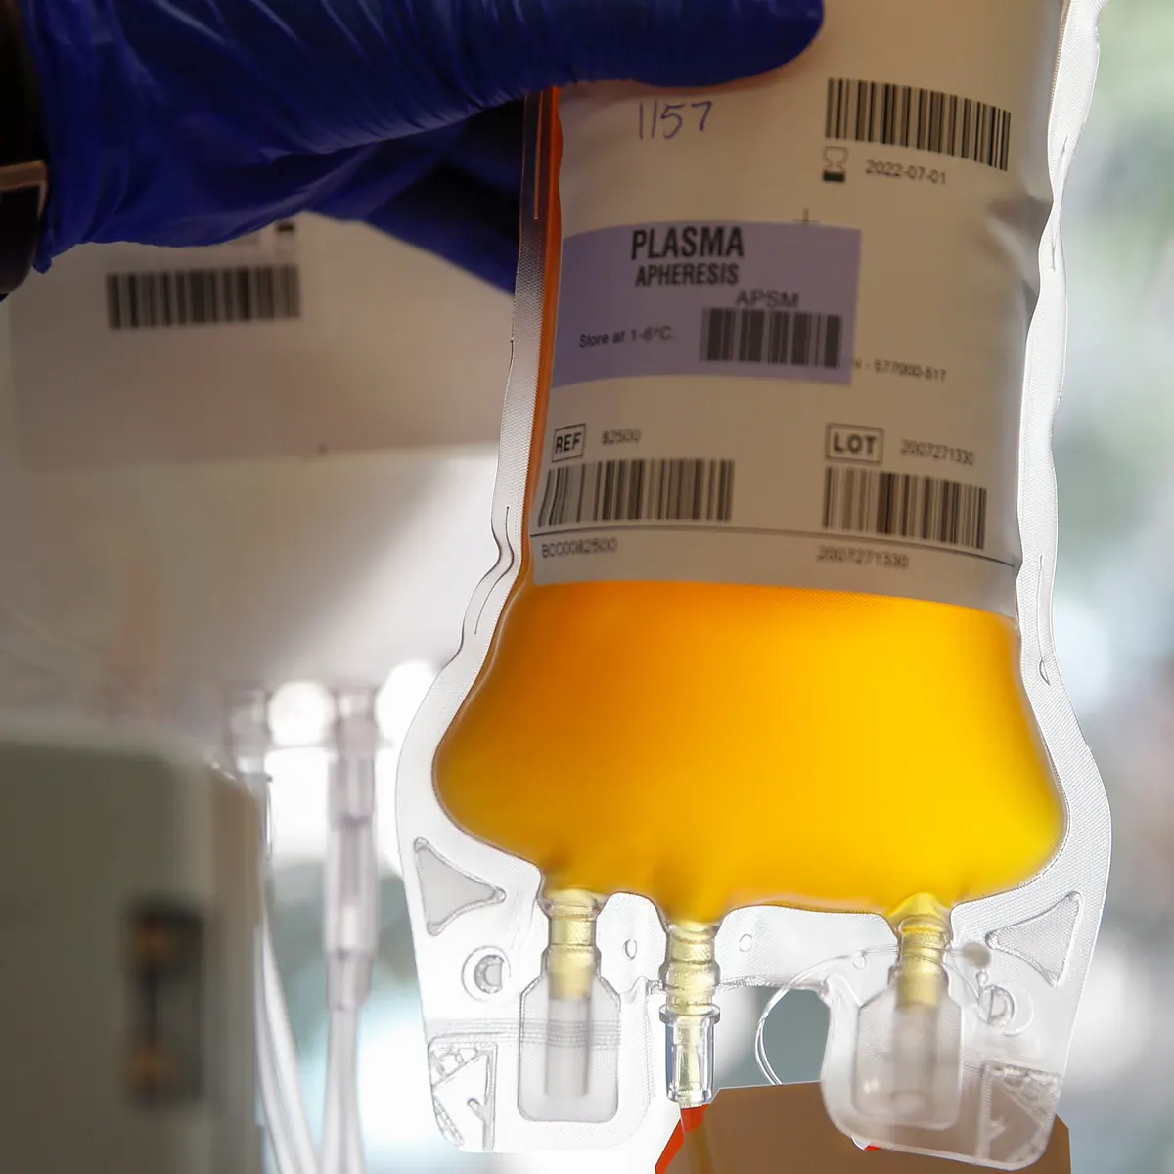
Handing/Returns
Red Blood Cells
Handing
Once dispensed, any PRBCs shall be immediately transported directly to the Hospital requesting the component for transfusion.
Returns
If the transfusion cannot be initiated within a time frame that would allow for completion within 4 hours of time issued, return the PRBCs to the Blood Bank.
Plasma
Handing
Once dispensed, any plasma shall be immediately transported directly to the Hospital requesting the component for transfusion.
Returns
If the transfusion cannot be initiated within a time frame that would allow for completion within 4 hours of time issued, return the Plasma to the Blood Bank.
4

Slide 7
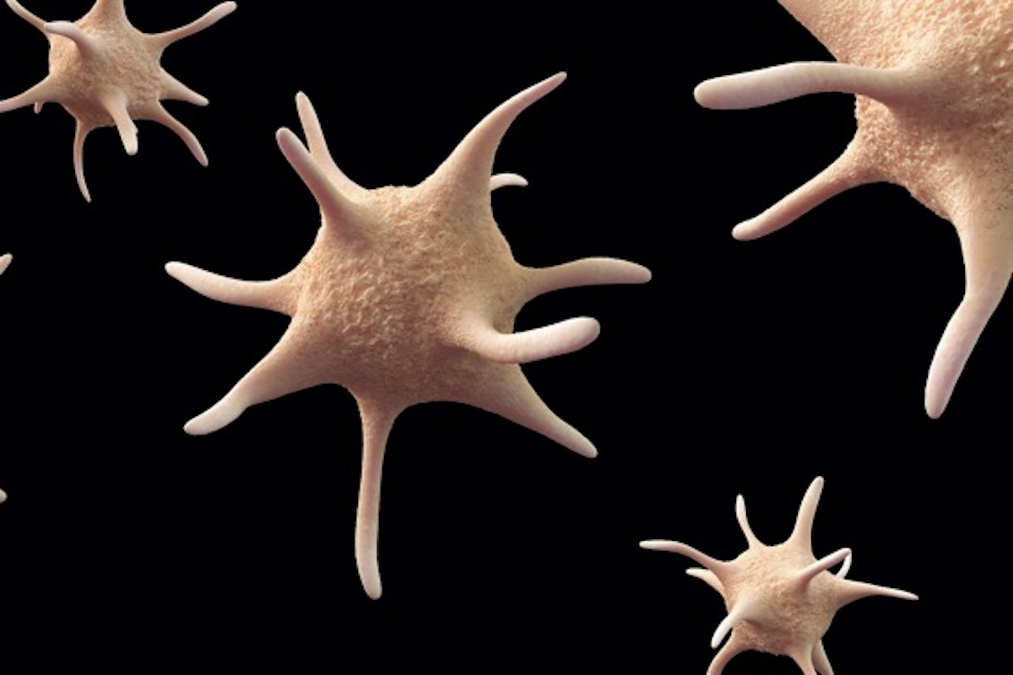
Platelets
Handing
Once dispensed, platelets shall be immediately transported directly to the RN or LIP requesting the component for transfusion.
Must remain at room temperature.
Never place inside a Blood Bank blood cooler for any reason.
Returns
Return as soon as possible if the component is not able to be transfused.
Copyright © utmb Health
5

Slide 8
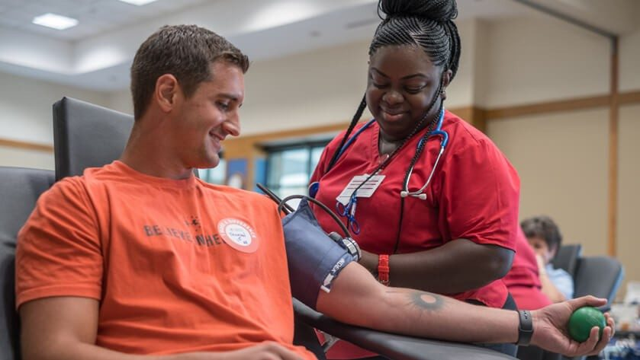
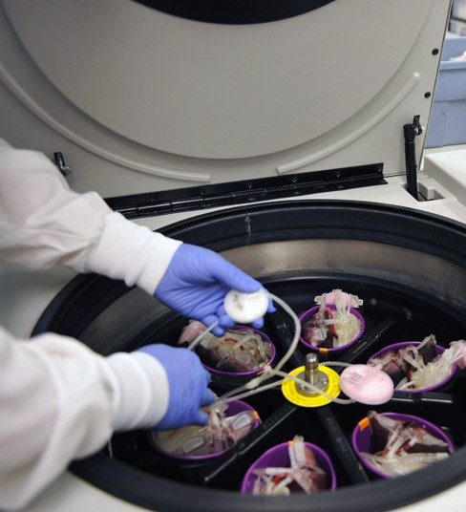
4.Learn About Each Step of the Blood Journey
Step One
The Donation
You arrive for your blood donation appointment.
Health history and mini physical are completed.
For a whole blood donation, about 1 pint of blood is collected; several small test tubes of blood are also collected for testing.
Your donation, test tubes and your donor record are labeled with an identical bar code label.
Your donation is kept on ice before being taken to a Red Cross center for processing; the test tubes go to the lab.
Step Two
Processing
At our processing center, information about your donation is scanned into a computer database.
Most whole blood donations are spun in centrifuges to separate it into transfusable components: red cells, platelets, and plasma.
Plasma may be processed into components such as cryoprecipitate, which helps control the risk of bleeding by helping blood to clot.
Red cells and platelets are leuko-reduced, which means your white cells are removed in order to reduce the possibility of the recipient having a reaction to the transfusion.
Each component is packaged as a “unit,” a standardized amount that doctors will use when transfusing a patient.
6

Slide 9
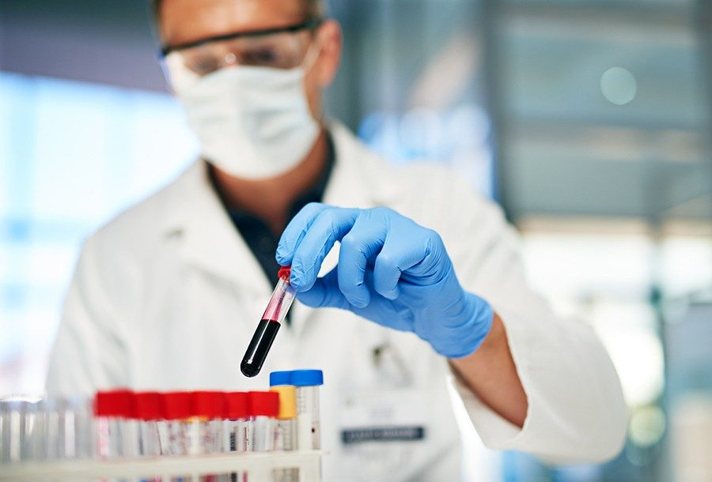
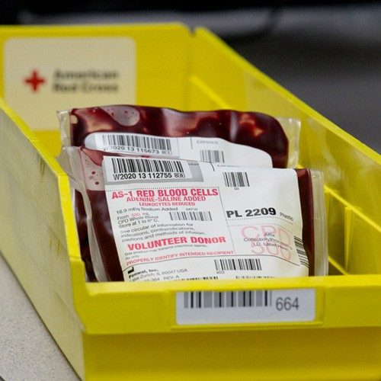
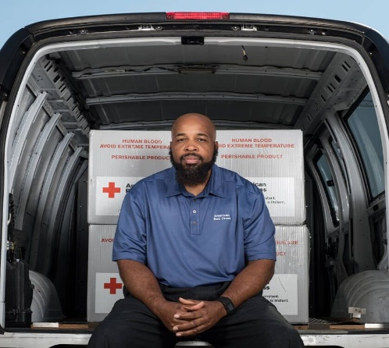
Step Three
Testing
In parallel with Step 2, your test tubes arrive at a testing laboratory.
A dozen tests are performed, to establish the blood type and test for infectious diseases.
Test results are transferred electronically to the processing center within 24 hours.
If a test result is positive, your donation will be discarded and you will be notified (our test results are confidential and are only shared with the donor, except as may be required by law).
Step Four
Storage
When test results are received, units suitable for transfusion are labeled and stored.
Red cells are stored in refrigerators at 6ºC for up to 42 days.
Platelets are stored at room temperature in agitators for up to five days.
Plasma and cryo are frozen and stored in freezers for up to one year.
Step Five
Distribution
Blood is available to be shipped to hospitals 24 hours a day, 7 days a week.
Hospitals typically keep some blood units on their shelves, but may call for more at any time, such as in case of large scale emergencies.
7

Slide 10
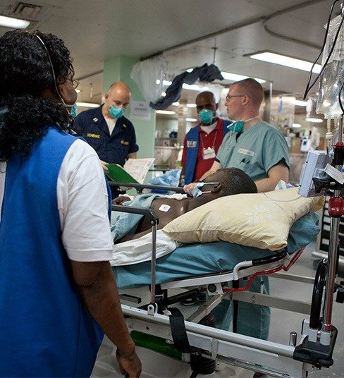
Step Six
Transfusion
An ill or injured patient arrives at a hospital or treatment center.
Physicians determine whether the patient requires a transfusion and, if so, which type.
Blood transfusions are given to patients in a wide range of circumstances, including serious injuries (such as in a car crash) surgeries, child birth, anemia, blood disorders, cancer treatments, and many others.
A patient suffering from an iron deficiency or anemia may receive red blood cells to increase their hemoglobin and iron levels, improving the amount of oxygen in the body.
Patients who are unable to make enough platelets, due to illness or chemotherapy, may receive platelet transfusions to stay healthy.
Plasma transfusions are used for patients with liver failure, severe infections, and serious burns.
Copyright © American Red Cross
8

Slide 11
5.Advantages and disadvantages of donating blood
Advantages of blood donation
Donating blood can help people with many health conditions, such as those who:
have internal or external bleeding due to an injury
have sickle cell disease or another illness that affects the blood
are undergoing cancer treatment
are undergoing surgery, such as cardiovascular or orthopedic surgery
are undergoing a transplant
need treatments involving plasma or other blood products
Disadvantages
Temporary reactions
Sometimes, a person can experience side effects after donating blood.
Although severe adverse effects are rare, temporary reactions can occur, including:
weakness
dizziness
bleeding from the needle prick
bleeding under the skin or bruising
These symptoms usually disappear within 24 hours.
Copyright © MedicalNewsToday
9

Slide 12
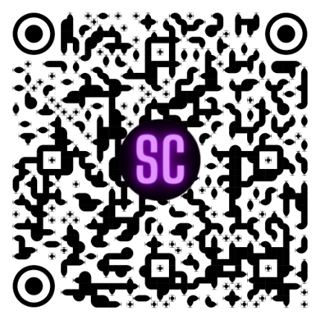
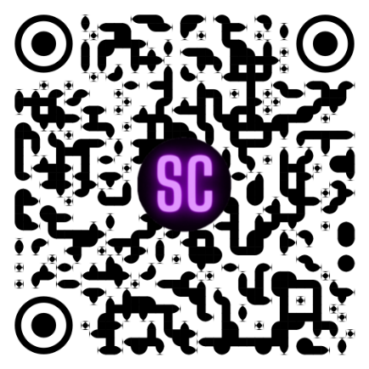



QR Code
Methods of Storing and Handing/Returns Donated Blood
Important To Donate Blood
Blood Donor Eligibility Criteria
Learn About Each Step of the Blood Journey
Advantages and disadvantages of donating blood
10

